Slide 1

Python! Day 20
Finishing the US States game
List comprehension

Slide 2
Step 10: Final Touches
This part’s optional but can really make our game feel more polished
We can:
Make the screen fit the image better:
s.setup(width=750, height=500)
We might need to mess with the numbers to see what fits best
Only print the missed states if the player doesn’t get all 50 states
if num_states_guessed < 50:
print("You missed: ")
print(all_states)
Print a special message depending on how many states a person guesses

Slide 3
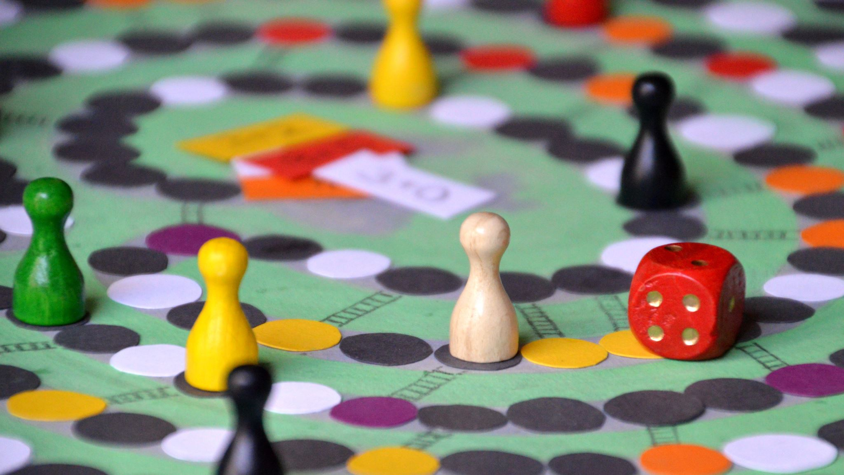
US State Guessing Game Finished!

Slide 4

Intro to List Comprehension
Let’s say we have a list: numbers = [1, 2, 3]
Now, let’s say we want a new list, which is the same as the numbers list, but every number is increased by 1
To do this, we would write something like this:
new_numbers = []
for n in numbers:
new_n = n + 1
new_numbers.append(new_n)

Slide 5
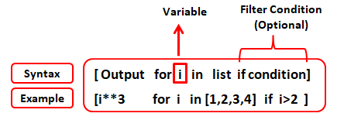
While this works, and we’ve used this method many times before, we can make this new list much easier using list comprehension
List comprehension looks like this:
new_list = [new_item for item in list]
To make our increased numbers list, we would write:
numbers = [1, 2, 3]
new_numbers = [num + 1 for num in numbers]
This is much quicker than using the for-loop method

Slide 6
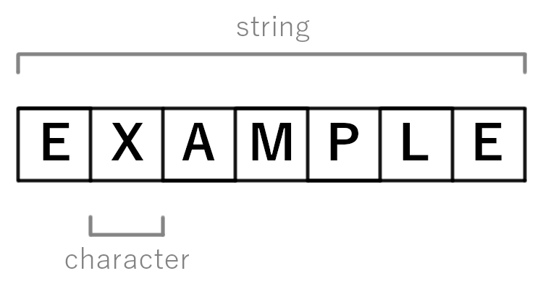
List Comprehension with Strings
We can also use list comprehension with strings instead of lists to look at individual letters
For example:
word = “summer”
letters = [letter for letter in word]
This will create a list of letters that looks like this:
[‘s’, ‘u’, ‘m’, ‘m’, ‘e’, ‘r’]
Try writing some code that takes a word input by the user and prints all of the word’s letters capitalized

Slide 7
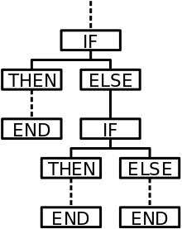
List Comprehension with Conditionals
There is also another form of list comprehension that looks like this:
new_list = [new_item for item in list if test]
This only adds the new item to the new list if the test condition is true
For example, we could use this to make our new number list only contain even numbers:
numbers = [1, 2, 3, 4, 5]
even_numbers = [num for num in numbers if num % 2 == 0]

Slide 8
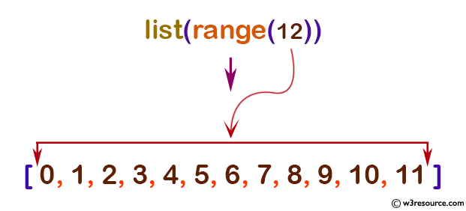
List Comprehension with range()
We can also do list comprehension with the range function
For example, we can create our original numbers list like this:
numbers = [num for num in range(1, 20)]
This would create this list:
[1, 2, 3, 4, 5, 6, 7, 8, 8, 9, 10, 11, 12, 13, 14, 15, 16, 17, 18, 19]
Try creating a list of all even numbers between 1 and 30 using only one line of code through list comprehension

Slide 9

List Comprehension Challenges
Let’s do some challenges to practice list comprehension
Take a list of numbers and create a list of the numbers squared (multiplied by themselves)
Get a string of numbers from user input and print a list of only the even numbers
Create two text files of numbers and print a list of the numbers that are in both files

Slide 10
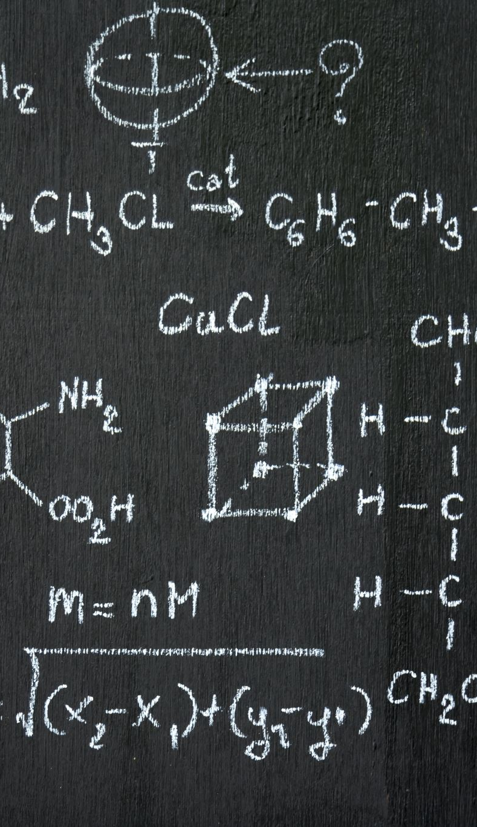
Challenge 1 and Challenge 2 Answers
Challenge 1:
numbers = [2, 34, 5, 8, 9]
sq_nums = [n * n for n in numbers]
Challenge 2:
num_str = input(“Type some numbers: “)
num_ints = [int(num) for num in num_str]
even_nums = [n for n in num_ints if n % 2 == 0]

Slide 11
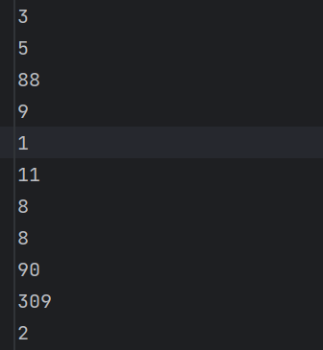
Challenge 3 Setup
To setup challenge 3, first, we need to create the two text files we’ll be comparing
To do this, create new files called text_1.txt and text_2.txt and write a random number on each line of the file
Now, we need to open these files in our main.py folder and use the file.readlines() method to get a list of the numbers
Now we can use list comprehension to make the string lists into int lists and use the in keyword to check if a number is in the other list

Slide 12
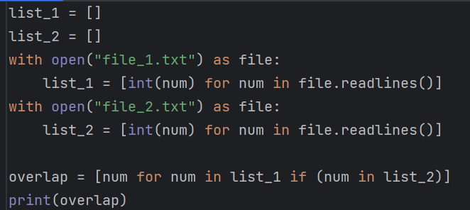

Slide 13

Dictionary Comprehension
There is also a dictionary form of list comprehension that looks like this:
new_dict = {new_key:new_value for item in list}
This creates a new dictionary from a known list
There is another form of dictionary comprehension that looks like this:
new_dict = {new_key:new_value for (key, value) in dictionary.items()}
This creates a new dictionary from a known dictionary

Slide 14

Dictionary Comprehension Example
Let’s create a list called “students” that has a whole bunch of student names:
students = [“Alex”, “Bella”, “Carson”, “Damien”, “Fred”]
Now, let’s use dictionary comprehension to create a dictionary where we pair each of these students with a randomly created test score
import random
student_scores = {student:random.randint(1, 100) for student in students}

Slide 15
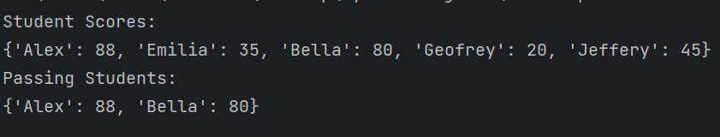
Dictionary Comprehension Example
Now, we can create another dictionary with the students who passed the test (score >= 50)
passed_students = {student:score for (student, score) in student_scores.items() if score >= 50}

Slide 16
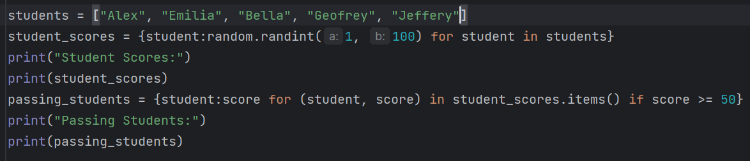

Slide 17

Dictionary Comprehension Challenges
Take a sentence and use the string.split() method and dictionary comprehension to create a dictionary with each word as the keys and the words’ length as the values
Take a dictionary of days and the Celsius temperature and create a dictionary with each day’s Fahrenheit temperature

Slide 18
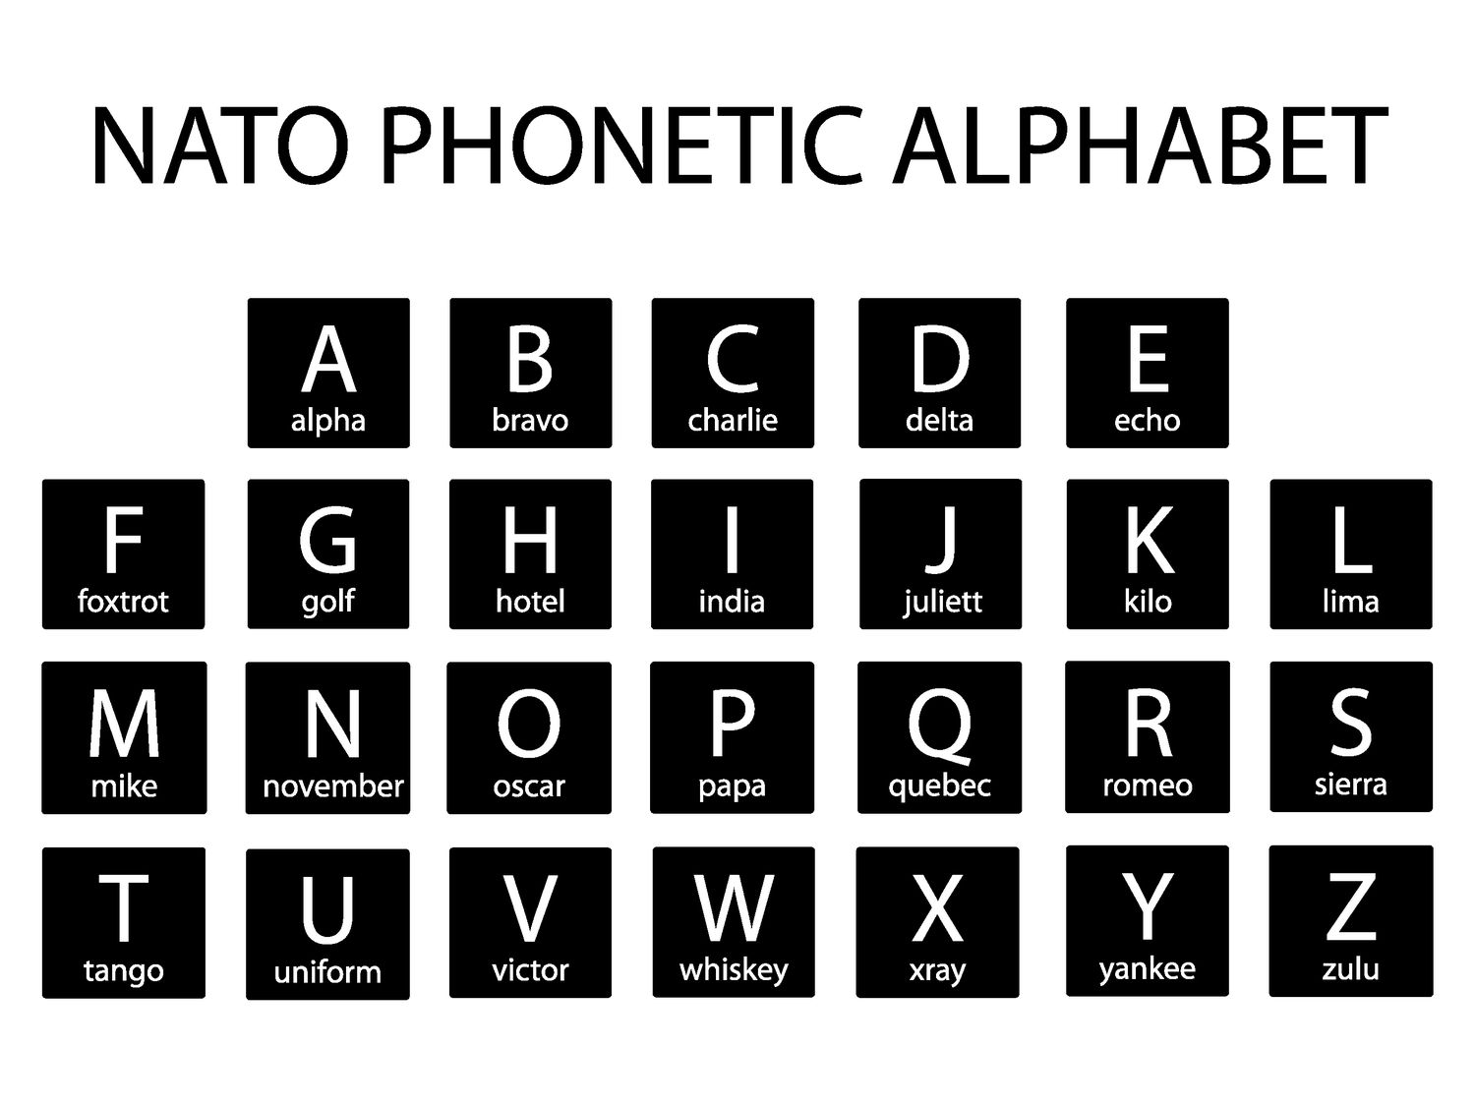
Project: NATO Alphabet Translation
Sometimes, when someone is spelling something on the phone or when speaking to someone, they might say something like “Apple - A for alpha, P for papa, P for papa, L for lima, E for echo”
This is to make sure the person you’re speaking to knows what letters you’re referring to
But, sometimes, it can be hard to think of the correct word on the spot when spelling something, so let’s write a program that does it for us
We can use the official NATO alphabet for our project

Slide 19
Project: NATO Alphabet Translation - Setup
First, we’re going to have to import and install pandas
To download pandas: Main Menu/Python > Settings > Project:50StateGame > Python Interpreter > +
Now, search ‘pandas’ in the search bar, click on the pandas module, and press ‘install package’
Now let’s download the NATO alphabet CSV file from my Github repository and drag it into our project
https://github.com/Tavishi27/Tuesday-Python-Files
The file is in the 4-2 branch
Finally, import pandas in our main.py file

Slide 20
Project: NATO Alphabet Translation – Reading the CSV
First, let’s read the CSV in our main.py file
alphabet = pandas.read_csv(“nato_phonetic_alphabet.csv”)
Next, we’ll want to create a dictionary in this format:
{“A” : “Alpha”, “B” : “Bravo” …}
Right now, if we use .to_dict() on our DataFrame, we can see that our DataFrame is not in the correct format
To fix this, we can use dictionary comprehension on our DataFrame to create a new, useable dictionary

Slide 21

Project: NATO Alphabet Translation – Creating a Dictionary
Using dictionary comprehension on a DataFrame uses this format:
dict = {new_key:new_value for (index, row) in data_frame.iterrows()}
So, to create our dictionary, we can write:
dict = {row[“letter”]:row[“code”] for (index, row) in alphabet.iterrows()}

Slide 22
Project: NATO Alphabet Translation – Get and Translate the User’s Word
alphabet = pd.read_csv("nato_phonetic_alphabet.csv")
dict = {row["letter"]:row["code"] for (index, row) in alphabet.iterrows()}
word = input("Enter a word: ").upper()
translated_word = [dict[letter] for letter in word]
print(translated_word)

